Slide 1

Geometry
Unit 4, Lesson 2 Algebraic Descriptions for Reflections Volume 1, pg. 184

Slide 2


Benchmark
MA.912.GR.2.1
Given a pre-image and image, describe the transformation and represent the transformation algebraically using coordinates.
volume 1, pg. 184

Slide 3
Integrated Mathematical Thinking and Reasoning Standards
MA.K12.MTR.1.1 Actively participate in effortful learning both individually and collectively.
MA.K12.MTR.2.1 Demonstrate understanding by representing problems in multiple ways.
MA.K12.MTR.3.1 Complete tasks with mathematical fluency.
MA.K12.MTR.4.1 Engage in discussions that reflect on the mathematical thinking of self and others.
MA.K12.MTR.5.1 Use patterns and structure to help understand and connect mathematical concepts.
MA.K12.MTR.6.1 Assess the reasonableness of solutions.
volume 1, pg. 184

Slide 4

Learning Target
I can relate a reflection on the coordinate plane to an algebraic notation of the transformation.
volume 1, pg. 184

Slide 5

Warm-Up
volume 1, pg. 184

Slide 6

4.2.1 Warm-Up: Moving Circles
Move any three circles so that the pyramid points down.
volume 1, pg. 184

Slide 7

Exploration
volume 1, pg. 185

Slide 8

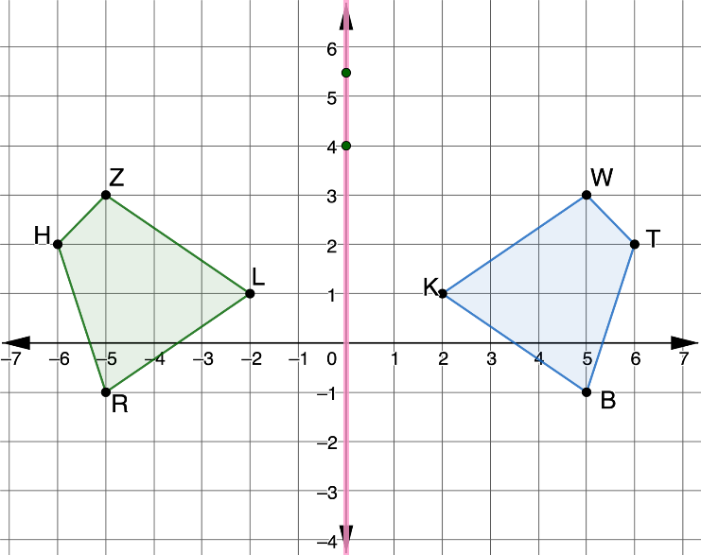
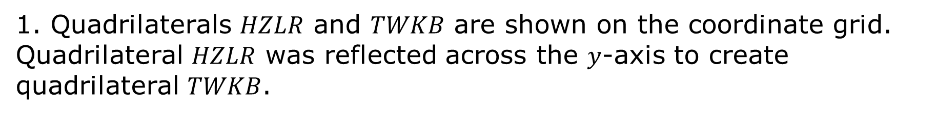
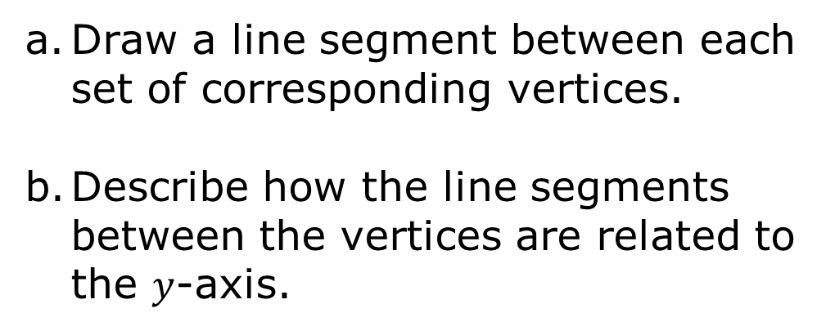
4.2.2 Exploration: Discovering Algebraic Descriptions for Reflections
1. Quadrilaterals $HZLR$ and $TWKB$ are shown on the coordinate grid. Quadrilateral $HZLR$ was reflected across the $y$-axis to create quadrilateral $TWKB$.
Draw a line segment between each set of corresponding vertices.
Describe how the line segments between the vertices are related to the $y$-axis.
volume 1, pg. 185

Slide 9
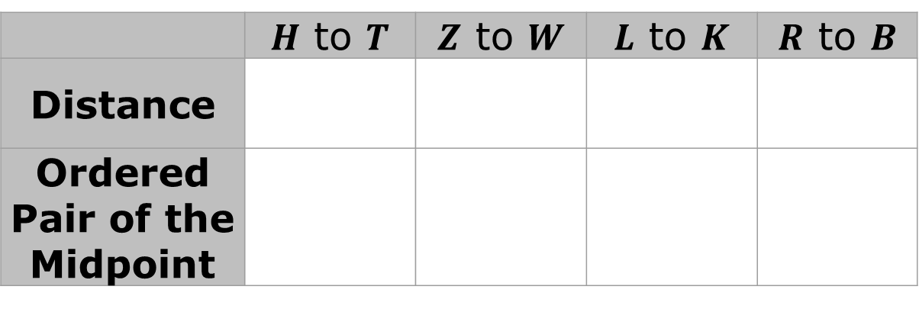
c. Complete the table.
 | $H$ to $T$ | $Z$ to $W$ | $L$ to $K$ | $R$ to $B$
Distance
Ordered Pair of the Midpoint
d. What do you notice about the midpoints?
volume 1, pg. 185

Slide 10
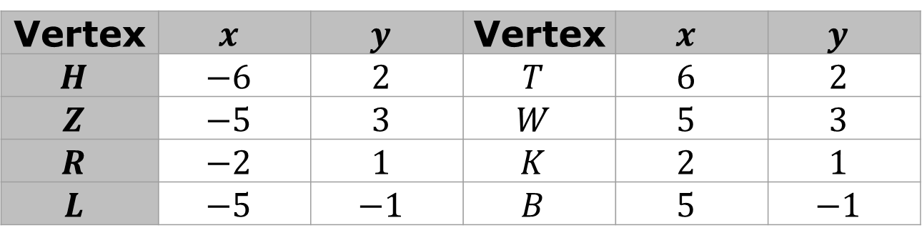
e. The table shows the coordinates of each vertex.
Vertex | $$x$$ | $$y$$ | Vertex | $$x$$ | $$y$$
$$H$$ | $$−6$$ | $$2$$ | $$T$$ | $$6$$ | $$2$$
$$Z$$ | $$−5$$ | $$3$$ | $$W$$ | $$5$$ | $$3$$
$$R$$ | $$−2$$ | $$1$$ | $$K$$ | $$2$$ | $$1$$
$$L$$ | $$−5$$ | $$−1$$ | $$B$$ | $$5$$ | $$−1$$
Work with your partner to describe how the coordinates of the pre-image, quadrilateral HZLR, are related to the coordinates of the image, quadrilateral TWKB.
volume 1, pg. 185

Slide 11
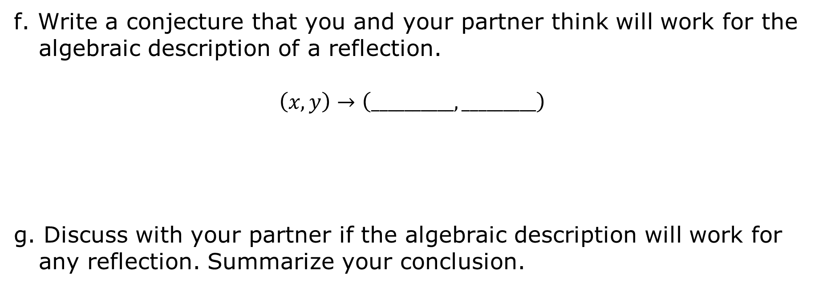
f. Write a conjecture that you and your partner think will work for the algebraic description of a reflection.
$$\left(x,y\right)→\left(__________,_________\right)$$
g. Discuss with your partner if the algebraic description will work for any reflection. Summarize your conclusion.
volume 1, pg. 186

Slide 12
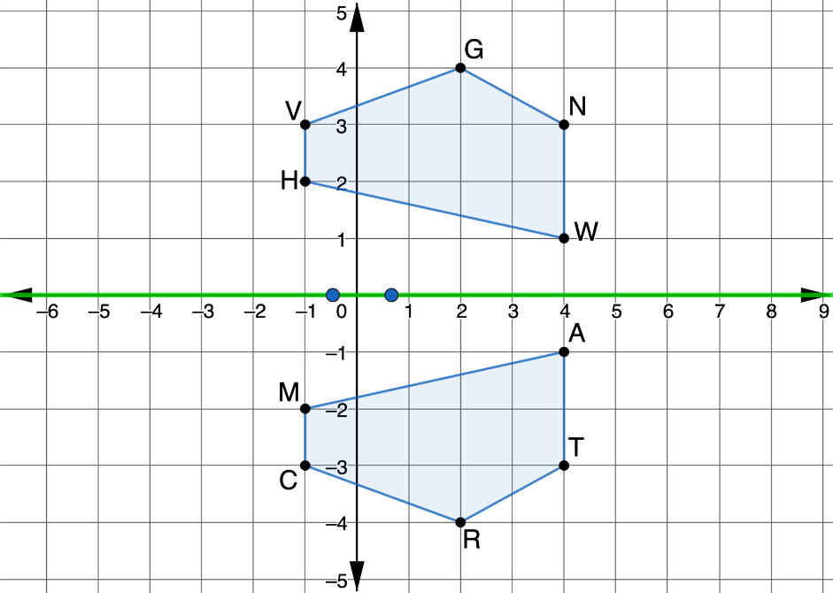
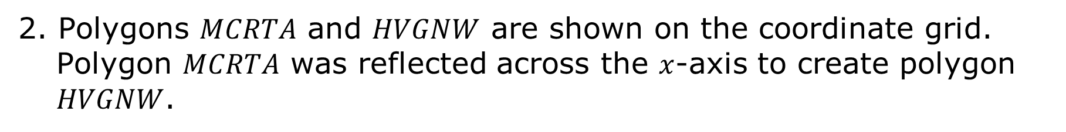
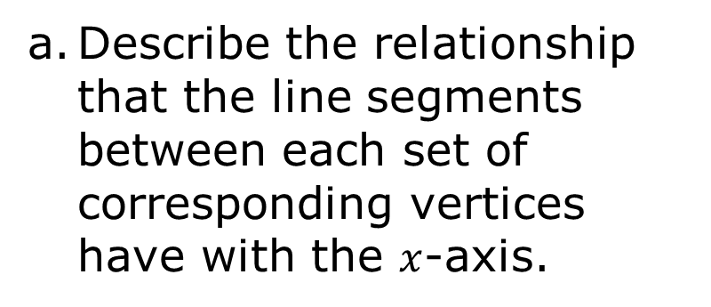
2. Polygons $MCRTA$ and $HVGNW$ are shown on the coordinate grid. Polygon $MCRTA$ was reflected across the $x$-axis to create polygon $HVGNW$.
Describe the relationship that the line segments between each set of corresponding vertices have with the $x$-axis.
volume 1, pg. 186

Slide 13
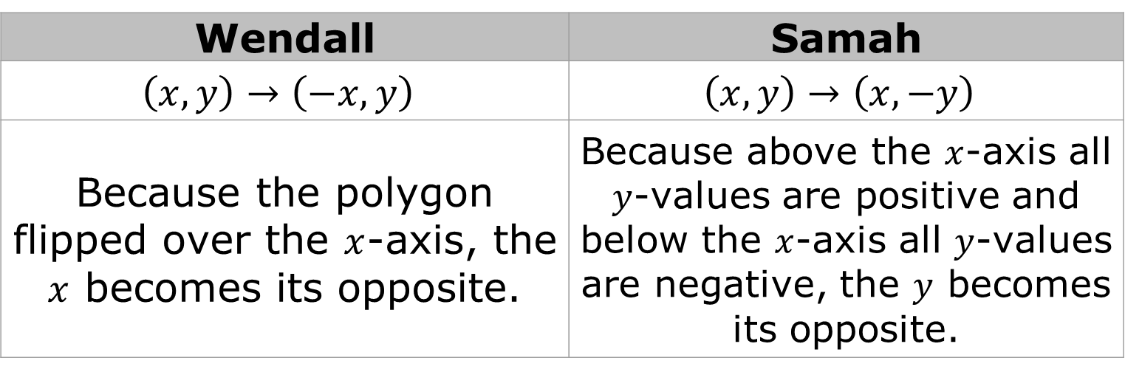
b. Wendall and Samah were working together on writing an algebraic description for reflections across the x-axis. Each student’s algebraic description and explanation of their thinking is shown in the table.
Wendall | Samah
$$\left(x,y\right)→\left(−x,y\right)$$ | $$\left(x,y\right)→\left(x,−y\right)$$
Because the polygon flipped over the $x$-axis, the $x$ becomes its opposite. | Because above the $x$-axis all $y$-values are positive and below the $x$-axis all $y$-values are negative, the $y$ becomes its opposite.
Discuss with your partner which, if any, algebraic description is correct. Use at least two ordered pairs from polygons MCRTA and HVGNW to defend your choice.
volume 1, pg.187

Slide 14
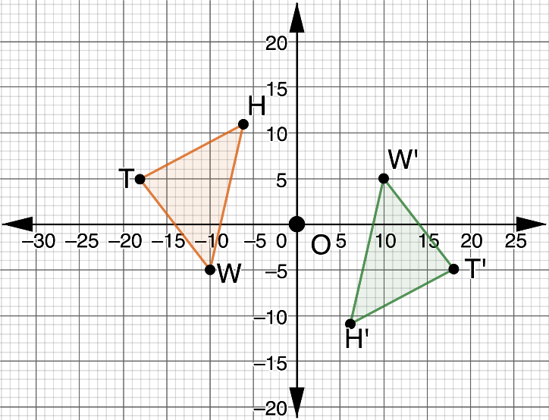
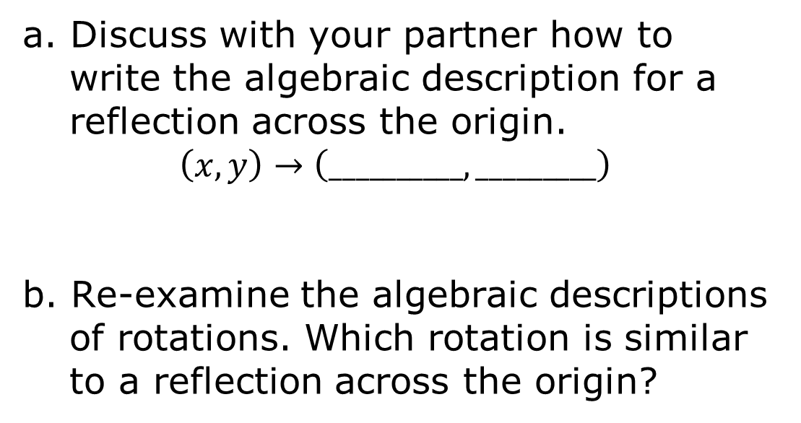
3. Triangles $HWT$ and $H′W′T′$ are shown on the coordinate grid. Triangle $HWT$ was reflected across the origin to create $∆H′W′T′$.
a. Discuss with your partner how to write the algebraic description for a reflection across the origin.
$$\left(x,y\right)→\left(__________,_________\right)$$
b. Re-examine the algebraic descriptions of rotations. Which rotation is similar to a reflection across the origin?
volume 1, pg. 187

Slide 15
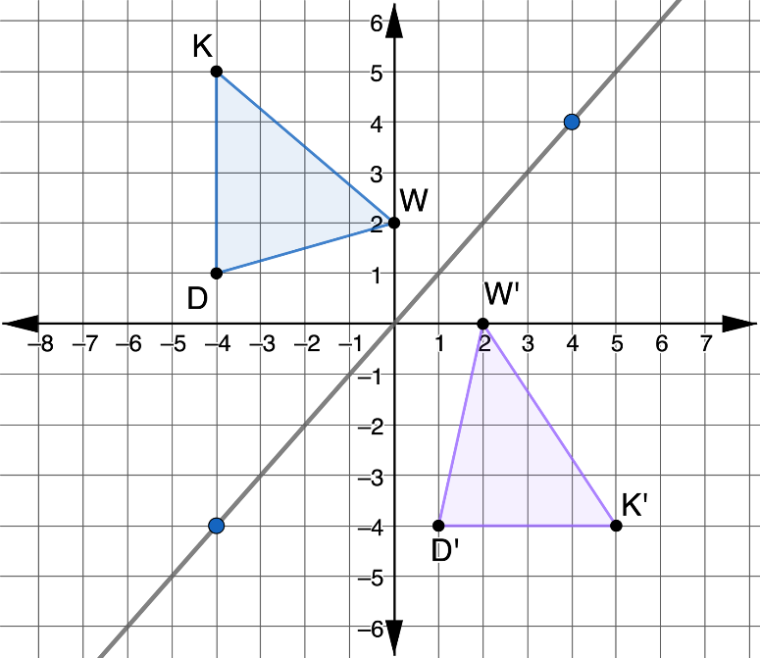
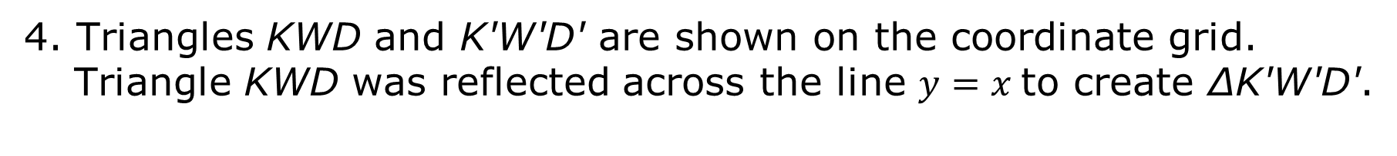
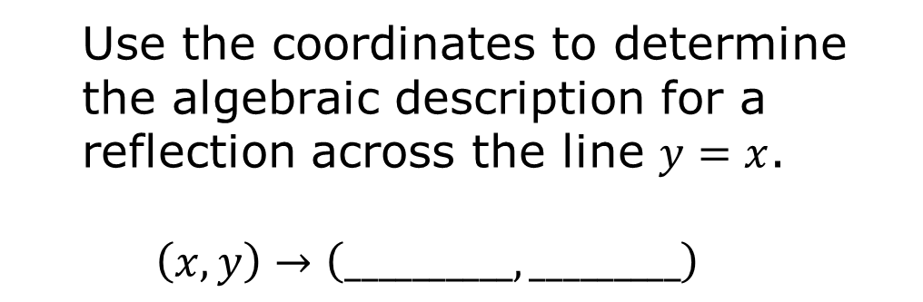
4. Triangles KWD and K'W'D' are shown on the coordinate grid. Triangle KWD was reflected across the line $y=x$to create ∆K'W'D'.
Use the coordinates to determine the algebraic description for a reflection across the line $y=x$.
$$\left(x,y\right)→\left(__________,_________\right)$$
volume 1, pg. 188

Slide 16
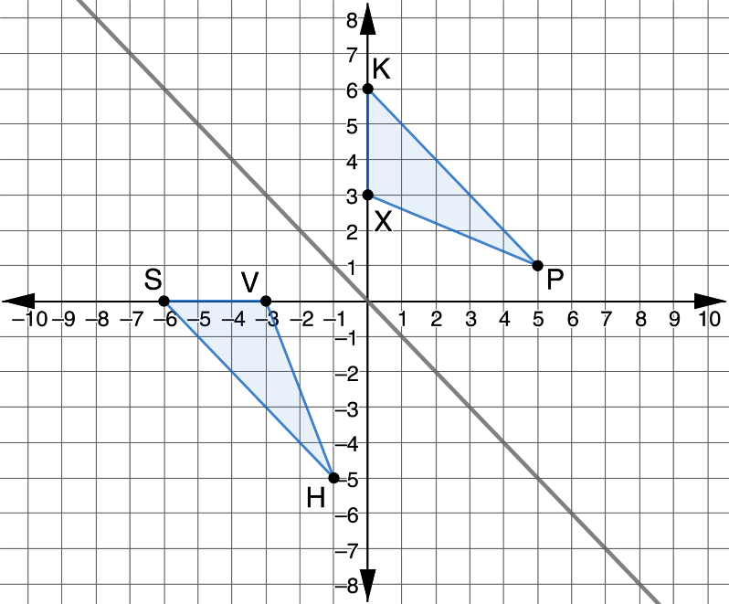
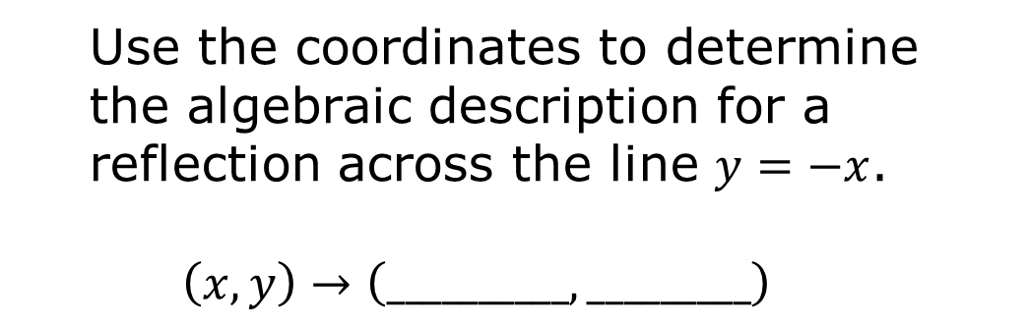
5. Triangles $HSV$ and $PKX$ are shown on the coordinate grid. Triangle $HSV$ was reflected across the line $y=−x$to create $∆PKX$.
Use the coordinates to determine the algebraic description for a reflection across the line $y=−x$.
$$\left(x,y\right)→\left(__________,_________\right)$$
volume 1, pg. 188

Slide 17

Bring It Together
volume 1, pg. 189

Slide 18

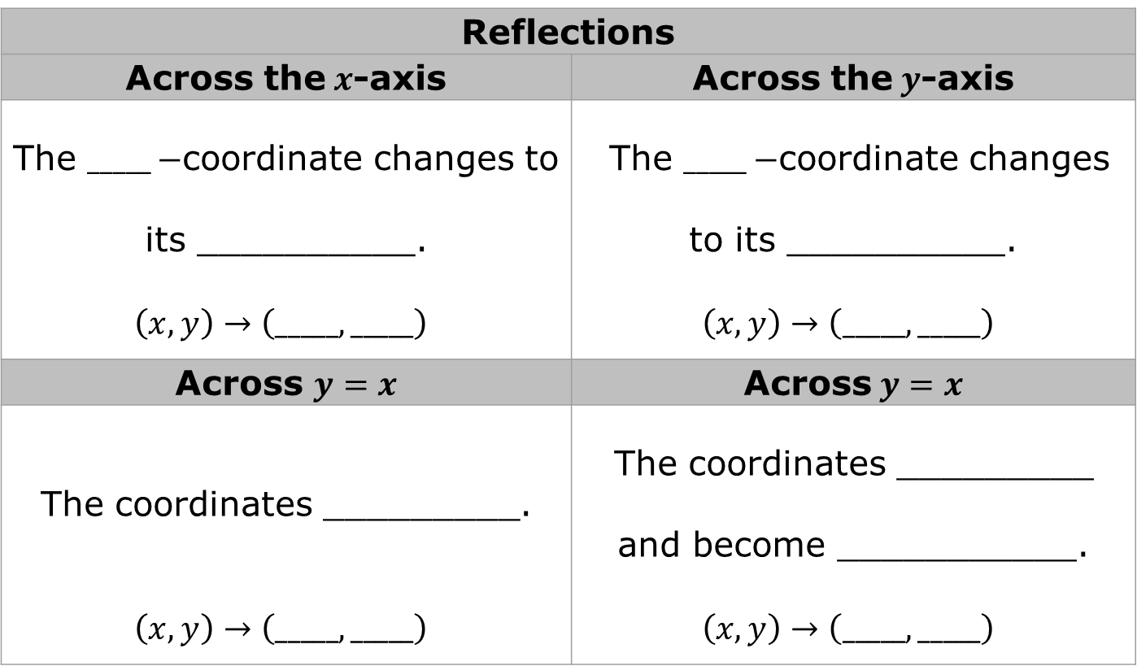
4.2.3 Bring It Together: Algebraic Descriptions for Reflections
Reflections
Across the$x$-axis | Across the$y$-axis
The $_____−$coordinate changes to its __________. | The $_____−$coordinate changes to its __________.
$$\left(x,y\right)→\left(_____,_____\right)$$ | $$\left(x,y\right)→\left(_____,_____\right)$$
Across $y=x$ | Across$y=x$
The coordinates _________. | The coordinates _________ and become ___________.
$$\left(x,y\right)→\left(_____,_____\right)$$ | $$\left(x,y\right)→\left(_____,_____\right)$$
volume 1, pg. 189

Slide 19

Wrap-Up
volume 1, pg. 189

Slide 20
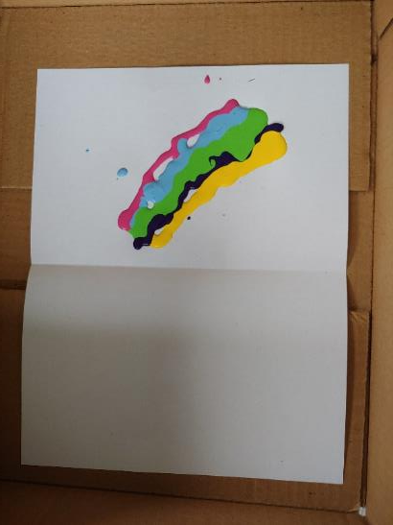
4.2.4 Wrap-Up: Cool Down
A reflection can be thought of as folding or "flipping" an object over the line of reflection. A squish painting is a fun application of a line of reflection.
To make a squish painting, a large sheet of construction paper is folded in half then opened up. Paint is dotted along one side of the fold. The paper is folded, and the folded paper is rubbed, pounded, and squished to move the paint around. The paper is then opened up to reveal the squish painting.
volume 1, pg. 189

Slide 21
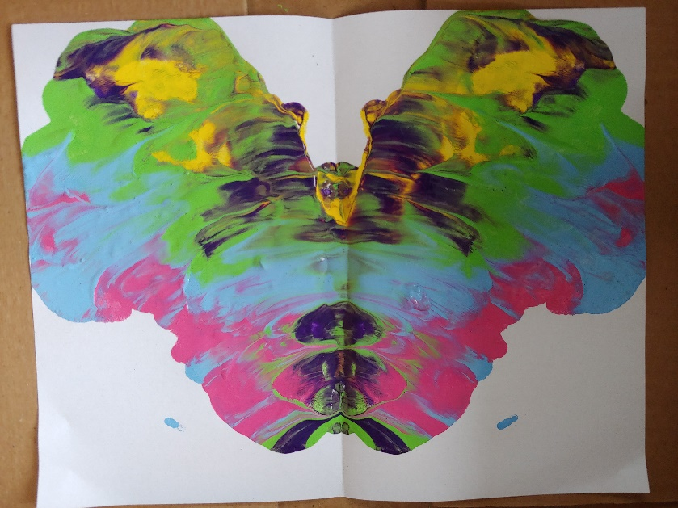
1. How does a squish painting show that in a reflection, each point of the original figure and its image are the same distance away from the line of reflection?
volume 1, pg. 189

